Slide 1


Introduction to Ext JS
An overview of the ExtJS
JavaScript Framework

Slide 3
What is Ext JS?
A pure JavaScript application Framework for building interactive web applications.
Developed and Supported Sencha Inc
Using techniques such as Ajax, DHTML and DOM scriptong
Started as extension to Yahoo's YUI

Slide 4
Why Ext JS?
Rich, Modern UI Widgets (more than 150 user interface components)
Fast to develop
Mature library
Extensible, object-oriented architecture
MVC, MVVM support
Good documentation and community support (over 1000 docs APIs)
Cross Browser Support

Slide 5

Introduction to Ext JS
An overview of the ExtJS JavaScript Framework
01
18.06
2015

Slide 6


Sencha Ext JS
Rapidly design, develop, and manage cross-platform web applications

Slide 7

What is Ext JS?
A pure JavaScript application Framework for building interactive web applications.
Developed and Supported Sencha Inc
Using techniques such as Ajax, DHTML and DOM scriptong
Started as extension to Yahoo's YUI
01
Notes:
Ext JS History:
Ext JS is a client-side, JavaScript framework for building web applications. In early 2006, Jack Slocum (jackslocum.com) started working on a set of extension utilities for the Yahoo User Interface (YUI) library under the name "yui-ext." Eventually, Jack created an adapter layer through which any foundation library could be plugged in to provide utilities such as event handling, DOM manipulation and animated effects. This unanchored the library from YUI, and allowed the use of YUI, jQuery, prototype, or a new ext-base foundation written by Jack. This was version 1 of Ext JS. Current version of Ext JS is 4.2.x.
IDE:
You can use any IDE for Sencha development as per your convenient eg. Webstorm, Aptana, Eclipse, VisualStudio etc.
IDE should satisfy following requirements for the development:
It should be able to validate JavaScript code for errors and warnings
It should have autoComplete functionality for ExtJS 4 library classes and functions.
It should be able to format JavaScript code easily to make Ext JS code readable.

Slide 8
Why Ext JS?
Rich, Modern UI Widgets (more than 150 user interface components)
Fast to develop
Mature library
Extensible, object-oriented architecture
MVC, MVVM support
Good documentation and community support (over 1000 docs APIs)
Cross Browser Support
01
Notes:
ExtJS 4.0 was released around April 2011
Ext JS 5.0 was released on June 2, 2014 : using a single code base, a Model View ViewModel (MVVM) architecture, two-way data binding, responsive layouts, and other component upgrades with support for adding widgets inside a grid cell for data visualization and big data analytics
ExtJS 5.1.0 / November 2014

Slide 9

10K
60%
2015 Ext JS Growth Statistics
Customers worldwide
Of fortune 100 companies
2M
7.2M
7.2M
Sencha devs wordwide
Product download
Active forum members

Slide 10

10K
60%
2015 Ext JS Growth Statistics
Framework for building mobile application
Other Sencha Products
Sencha Touch
Sencha.io
Customers worldwide
Of fortune 100 companies
Cloud services for mobile
Ext Designer
Wysiwig tool for ExtJS
2M
7.2M
7.2M
Sencha Animation
Tool for designing CSS3 animations
Design
Develop
Ext controls available for Google Web Toolkit
Ext GWT
Plugins & Services
Sencha devs wordwide
Product download
Active forum members
Manage
Notes:
Sencha Platform for Web Application Lifecycle Management
Sencha Ext JS
Sencha Ext JS is a desktop application development platform with cross-browser compatibility, MVC architecture, charting, and UI widgets.
Sencha Touch is a mobile application development platform with over 50 built-in components, themes for every popular mobile platform, and a built-in MVC system. Sencha Touch in the Complete package provides access to TouchGrid and Action Message Format (AMF).
Design
The Sencha platform helps you accelerate your web application development efforts with out-of-the box theming capabilities across all applications. We can help teams:
Design visually compelling web applications using pre-built and pre-tested components.
Improve agility and the overall design process with tools that make it faster and easier to mock up, style, prototype, and evaluate interface designs.
Enhance collaboration between line-of-business and IT teams to move apps quickly to the development phase.
Develop
The Sencha platform offers powerful JavaScript and Java frameworks to help developers do their best work. We can help teams:
Build better applications faster with an enterprise-ready framework.
Improve development efficiency by automatically handling critical issues such as rendering and cross-browser testing.
Build higher quality applications with tightly integrated and well-tested libraries and components.
Develop once for multiple platforms and devices.
Code, troubleshoot, and test web applications just once for multiple device types — desktops, tablets, and smartphones.
Manage
Sencha offers the ideal platform for deploying, managing, securing, and analyzing your web applications. We can help IT Ops teams:
Seamlessly deploy web applications to mobile devices, tablets, and desktops.
Safeguard sensitive data by deploying apps securely.
Maintain user flexibility and increase IT/business collaboration.
Control your apps, users, and data with a centralized administration console.
Gain valuable insight by analyzing your apps across usage, timing, support, update, and performance parameters.
Plugins and Services
We provide an open platform that integrates into your current IT environment with plugins for popular IDEs, integration with backend systems such as SAP and integration with Single Sign on, LDAP and more. The Sencha Platform is backed by expert support and services that round out the solution. Our dedicated team of engineers and consultants provides deep technical training, customized implementation, technical support, and professional services that include:
Enterprise Mentoring and Architectural Planning
Dedicated Development Experts
Code Review and Best Practices Knowledge Transfer
Custom Component Development
UI/UX Design Assistance

Slide 11






Support major browser
IE 8+
6+
IE 10+ / Win 8
Ext JS 5
Chrome
Android 4.1+
12+
Notes:
IE: 11
Mozilla Firefox: 3.8
Safari: 8
Google Chrome: 43
Opera: 30
Note: Ext JS 5 does not currently support mobile phones

Slide 12
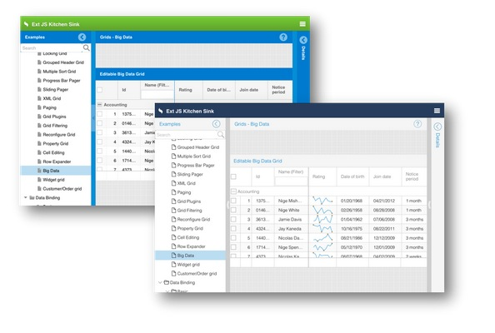
Containers
Notes:
Không phô trương JavaScript

Slide 13
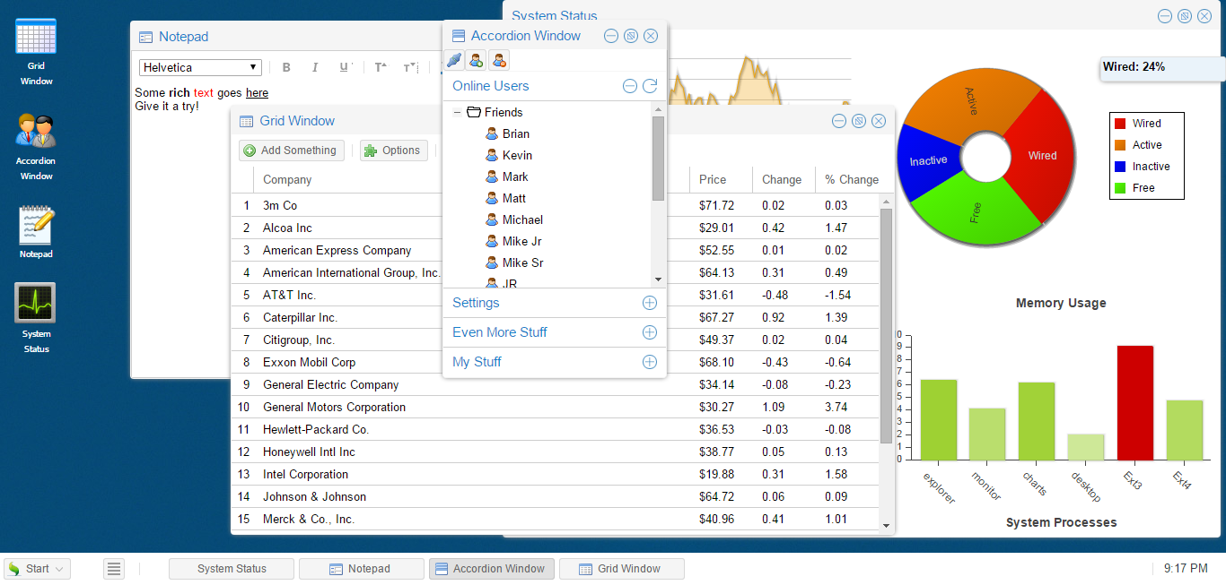
Extjs Web Desktop
Notes:
Windows looks like OS windows – support dragging/resizing/closing

Slide 14
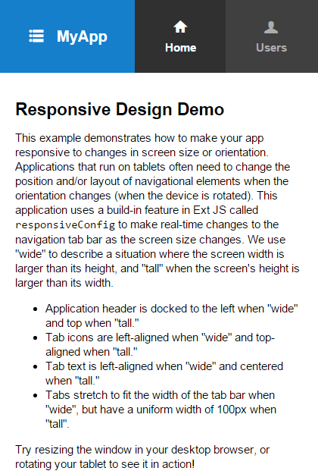
Extjs Responsive
Notes:
Windows looks like OS windows – support dragging/resizing/closing

Slide 15
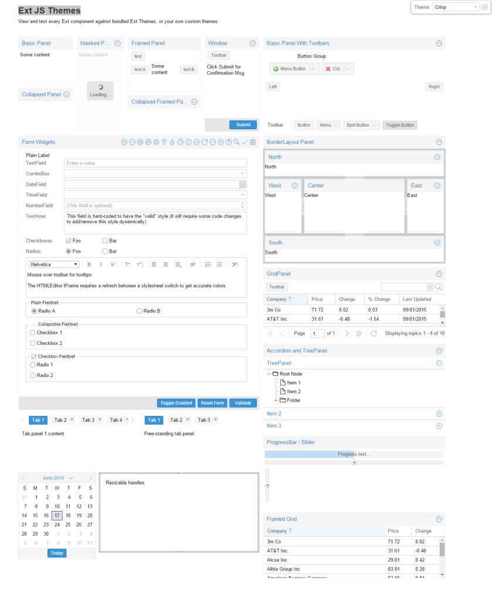
Ext JS Themes
Notes:
http://dev.sencha.com/ext/5.1.0/examples/themes/index.html

Slide 16
How do we begin?
Download GPL version of Sencha Ext JS 5.1 library(Download and Install Sencha Cmd)
Unzip using any file compression utility
from your webserver root directory: sencha -sdk /path/to/framework generate app MyApp my-app cd app sencha app watch
Now navigate to http://localhost:1841 or your native localhost
01
Notes:
License(s):
GNU General Public License v3.0
GNU General Public License v3.0 is the standard license for the GNU General Public License v3.0 base license
http://www.sencha.com/legal/
E:\Software Center\Framework\ext-5.1.0
Installing Sencha Ext JS
Sencha Ext JS is a desktop application development platform with cross-browser compatibility, MVC architecture, charting, and UI widgets.
Installing Sencha Touch
Sencha Touch is a mobile application development platform with over 50 built-in components, themes for every popular mobile platform, and a built-in MVC system. Sencha Touch in the Complete package provides access to TouchGrid and Action Message Format (AMF).
a. Create the starting file structure by changing directory: sencha generate app MyApp ../MyApp
You cannot include Sencha Ext JS or Sencha GXT in a closed source distribution under this license.

Slide 17
API Overview
Support Libraries
DOM selection/manipulation
Events
Utilities
AJAX
Layouts and Containers
Forms
Data Stores
01
Notes:
License(s):
GNU General Public License v3.0
GNU General Public License v3.0 is the standard license for the GNU General Public License v3.0 base license
http://www.sencha.com/legal/
E:\Software Center\Framework\ext-5.1.0
Installing Sencha Ext JS
Sencha Ext JS is a desktop application development platform with cross-browser compatibility, MVC architecture, charting, and UI widgets.
Installing Sencha Touch
Sencha Touch is a mobile application development platform with over 50 built-in components, themes for every popular mobile platform, and a built-in MVC system. Sencha Touch in the Complete package provides access to TouchGrid and Action Message Format (AMF).
a. Create the starting file structure by changing directory: sencha generate app MyApp ../MyApp
You cannot include Sencha Ext JS or Sencha GXT in a closed source distribution under this license.

Slide 18
Sample – DOM Manipulation
DOM Manipulation
Event
AJAX
Inheritance
01
Notes:
https://fiddle.sencha.com/#fiddle/3l1
http://www.extjs-tutorial.com/extjs/inheritance-in-extjs

Slide 19
ExtJS - View
https://docs.sencha.com/extjs/5.1/5.1.1-apidocs/#!/api/Ext.data.Store
01

